Slide 1
Lecture
Last Time: Combinational Circuits
Circuits → Boolean Algebra -> Circuits
Building up larger comments
half and full adders
sum of products
1-bit → N-bit operations
Binary Addition and Subtraction
Binary Coded Decimal (BCD) Addition
Today:
On-Off Switch: Not Data, but a Control Line
Decoders and Multiplexers
1-bit Arithmetic and Logic Unit (ALU)
Schematic of the CPU
Schematic of Main Memory
Nextime: State and MicroArchitecture
Sequential Circuits: clocks, latches, and flip/flops:
CPU Control: PC/IR
MIPS pipeline architecture

Slide 2



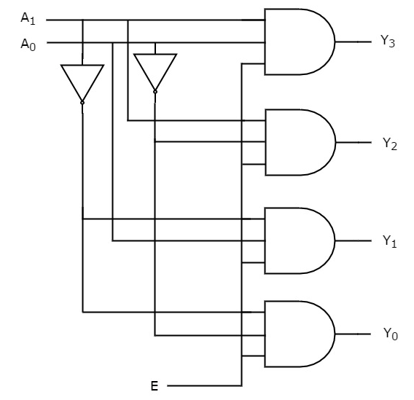
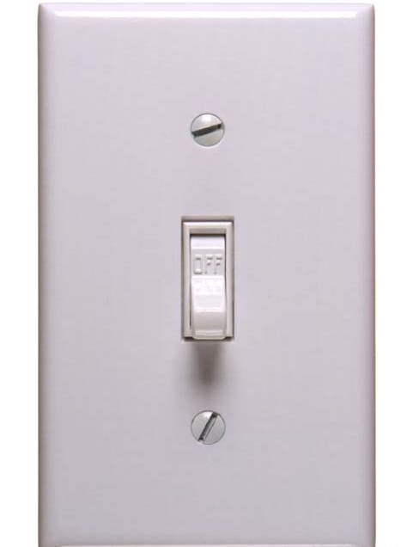
Data Lines and Control Lines
A
B
All lines (wires) carry either a 0 or a 1
In the XOR circuit, we perceive these values to be data
In other circuits, e.g., decoder, some lines are for control
On-Off Switch:
Use to turn on or turn off circuits
A₁
0
Y₃
A₀
?
Y₂
0
Y₁
E
0
Y₀

Slide 3
Data Lines and Control Lines
A
B
All lines (wires) carry either a 0 or a 1
In the XOR circuit, we perceive these values to be data
In other circuits, e.g., decoder, some lines are for control
On-Off Switch:
Use to turn on or turn off circuits
C is a control line, D is a data line
A₁
0
Y₃
A₀
?
Y₂
0
Y₁
E
0
Y₀
D | C | Output (and)
0 | 0 (Off) | 0 (Off)
0 | 1 (On) | 0
1 | 0 (Off) | 0 (Off)
1 | 1 (On) | 1
C
D

Slide 4
Decoder Motivation
Consider a two 4-bit registers
Use an On-Off switch to enable all the data lines from a register
C₀ and C₁ controls whether or not the register is selected
X₃ | X₂ | X₁ | X₀
C₁
Y₃ | Y₂ | Y₁ | Y₀
C₀

Slide 5
Decoder Motivation
Consider a two 4-bit registers
Use an On-Off switch to enable all the data lines from a register
Use 1-to-2 Decoder to select which register:
E: enables the decoder
A: controls which register to enable
X₃ | X₂ | X₁ | X₀
C₁
A₀
Decoder
Y₃ | Y₂ | Y₁ | Y₀
C₀
E

Slide 6
Decoder: 2-to-4
E | A₁ | A₀ | Y₃ | Y₂ | Y₁ | Y₀
0 | X | X | 0 | 0 | 0 | 0
1 | 0 | 0 |  |  |  | 1
1 | 0 | 1 |  |  | 1
1 | 1 | 0 |  | 1
1 | 1 | 1 | 1
N+1 Inputs:
E: An "enable" line to active the circuit
A: Think of it as a binary number
2^{n} Outputs: A output line is set
A₁
0
Y₃
A₀
?
Y₂
0
Y₁
E
0
Y₀

Slide 7
Decoder: 2-to-4, 3-to-8, 4-to-16, 5-to-32
E | A₁ | A₀ | Y₃ | Y₂ | Y₁ | Y₀
0 | X | X | 0 | 0 | 0 | 0
1 | 0 | 0 |  |  |  | 1
1 | 0 | 1 |  |  | 1
1 | 1 | 0 |  | 1
1 | 1 | 1 | 1
N+1 Inputs:
E: An "enable" line to active the circuit
A: Think of it as a binary number
2^{n} Outputs: A output line is set
A₁
Y₃
A₀
Y₃
Encoder
4-to-2
Y₂
A₁
Y₂
Y₁
Y₁
A₀
E
Y₀
Y₀
A1 | A0
1 | 0

Slide 8
Decoder and Register Selection
Consider a two 4-bit registers
Use an On-Off switch to enable all the data lines from a register
Use 1-to-2 Decoder to select which register:
E: enables the decoder
A: controls which register to enable
X₃ | X₂ | X₁ | X₀
C₁
At most one input will be set!
A₀
Y₃ | Y₂ | Y₁ | Y₀
C₀
E
X₀ I Y₀

Slide 9
Eight 4-bit Register Bank
8 = 2³: Hence I need a 3-to-8 decoder
Output to a single bus
Register Bank
5 == 101
1
Decoder
8
A₂
0
1
A₁
A₀
1
E
1
4

Slide 10
Eight 4-bit Register Bank
r7 = r1 + r4
R₁
8 = 2³: Hence I need a 3-to-8 decoder
Provide for two data paths
Register Bank
Decoder
1
0
1 == 001
0
8
0
Decoder
8
A₂
A₁
0
A₀
1
1
R₄
E
R₇
4
4
Left bus
Right bus

Slide 11
Two Data Paths: revisited
X₃ | X₂ | X₁ | X₀
C_{L}
decoder
C_{R}
decoder
Left bus
Right bus

Slide 12
CPU: Almost!
Register Bank (8 4-bit)
Decoder L bus
Decoder R bus
1 | 0 | 1
0 | 1 | 0
Assume:
X is stored in R₂
Y is stored in R₅
Java
O = X + Y MIPS:
ADD $r1, $r2, $r5
output = R₂ + R₅
L
R
1-bit ALU
1-bit ALU
1-bit ALU
1-bit ALU
4-bit ALU
C_{out}
C_{in}
1 | 1
Output Register
Output = X + Y

Slide 13
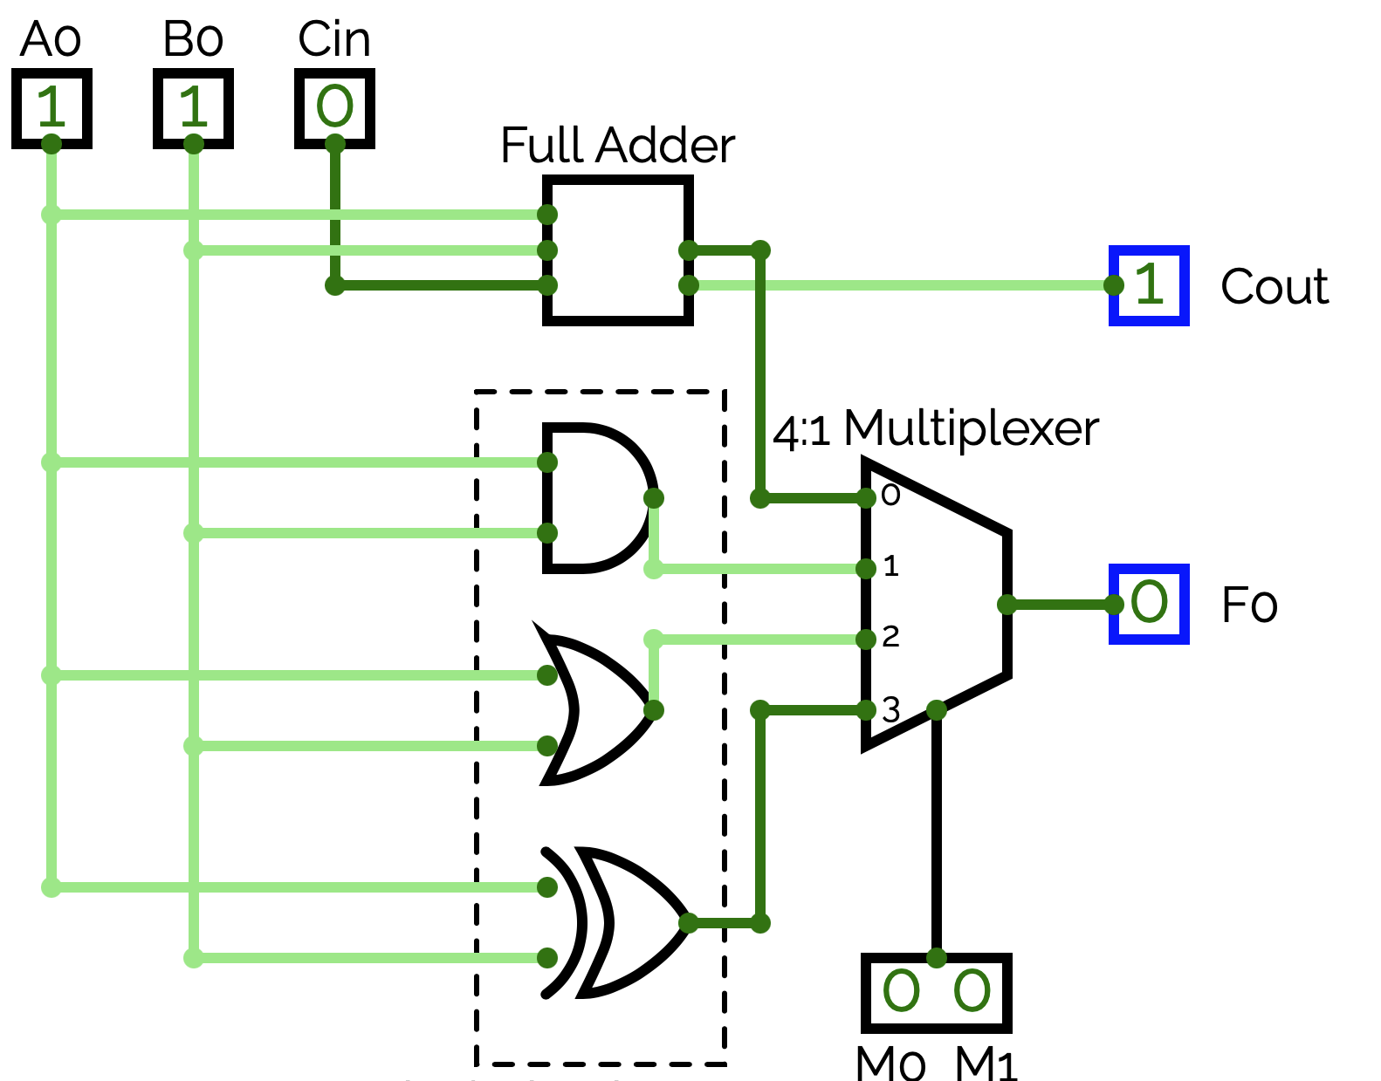
Arithmetic and Logical Unit (ALU)
All four functions are computed in parallel
Let's build an 1-bit ALU with 4 possible functions:
X₀ + X₀: Binary Addition
X₀ & Y₀: Bitwise AND
X₀ | Y₀: Bitwise OR
X₀ ^ Y₀: Bitwise XOR
X₀
Y₀
}
We need to select only one of these data lines

Slide 14
Multiplexer (Data Selector)
S₁ | S₀ | Y
0 | 0 | I₀
0 | 1 | I₁
1 | 0 | I₂
1 | 1 | I₃
Inputs:
2^{N} data input lines
N selector lines
Outputs:
1 dataline
1
I₃
Mux
4x1
0
I₂
1
Y
1
I₁
1
I₀
S₁
S₀

Slide 15
1-bit Arithmetic and Logical Unit (ALU)
All four functions are computed in parallel
Let's build an 1-bit ALU with 4 possible functions:
X₀ + Y₀: (3) Binary Addition
X₀ & Y₀: (2) Bitwise And
X₀ | Y₀: (1) Bitwise OR
X₀ ^ Y₀: (0) Bitwise XOR
X₀
Y₀
1 | 1
OP Code

Slide 16
Multiplexer for my ALU
Op
^
|
&
+
S₁ | S₀ | Y
0 | 0 | I₀
0 | 1 | I₁
1 | 0 | I₂
1 | 1 | I₃
mux
Inputs:
2^{N} data input lines
N selector lines
Outputs:
1 dataline
I₃
Mux
4x1
I₃
Mux
4x1
I₃
Mux
4x1
I₃
Mux
4x1
I₂
Y
I₂
Y
I₂
Y
I₂
Y
I₁
I₁
I₁
I₁
I₀
I₀
I₀
I₀
1
1
1
0
0
1
0
0
S₁
S₀
S₁
S₀
S₁
S₀
S₁
S₀
S₀

Slide 17
Multiplexer (Data Selector)
Inputs:
2^{N} data input lines
N selector lines
Outputs:
1 dataline
X
0
I₃
Mux
4x1
De-Mux
1x4
Y₃
X
?
I₂
Y₂
?
?
Y
I
?
0
I₁
Y₁
X
if S == 10
0
I₀
if S == 01
Y₀
0
1
1
0
S₁
S₀
S₁
S₀

Slide 18
CPU: Almost!
Register Bank (8 4-bit)
Decoder A bus
Decoder B bus
1 | 0 | 1
0 | 1 | 0
Assume:
X is stored in R₂
Y is stored in R₅
Java
O = X + Y MIPS:
ADD $r1, $r2, $r5
output = R₂ + R₅
Left
Right
C_{out}
1-bit ALU
1-bit ALU
1-bit ALU
1-bit ALU
C_{in}
1 | 1
Output Register
Output = X + Y

Slide 19
Schematic of Main Memory
Data Input
MBR: Memory Buffer Data Register
The width of the data path
MAR: Memory Address Register
The width must be large enough!
2¹⁶ ⇔ 64K (2³² ⇔ 4G)
read
Decoder
write
2¹⁶
Memory Bank
← 16 bits →
Data Output

Slide 20
Other Memory Organizations
91330 -8281
Array of memory banks
split into, say, 16 units
Address space split
4 msb (most significant bits) determine which unit to use: a total of 4 bits : 15..12
12 lsb (least significant bits) provide the internal address: a total of 12 bits : 11..0
2¹²
M₁₅
M₁
M₀
←4→
← 12 bits →
4-to-16
E

